Slide 1
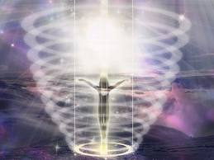
Science of Thoughts, Beliefs, Emotions and Subtle Energy
Science of Spiritual Beings of Light Lectures
Presented at Unity Church of Dallas
Oct 24, 31 - Nov 7, 14, 2011
By Doug Matzke, Ph.D.
Doug@QuantumDoug.com

Slide 2
Related Topics and Models
Information, memory and quantum speedup (1)
Protophysics spacetime and quantum models (1)
Metaphysics abilities and research (1)
Law of Attraction, inclusion based and vortex (2)
Meditation, Spiritual Experiences and Channels (2)
Thoughts, attention, consciousness and qualia (3)
Emotions and feelings (3)
Brains, neurons, heart intelligence and NLP (3)
Breathing and breathwork (3)
Chakras, Chi and Subtle energy (3)
Clearing, grounding, balancing and alignment (3)
(lecture #)

Slide 3
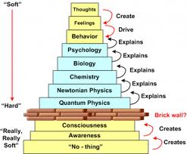
Meta Models Transcend Levels
“Soft”
No-thing
Awareness
Thoughts
Feelings
Consciousness
Explains or creates
Behaviors
Quantum
Psychology
Classical
Neurology
Chemistry
“Hard”
Biology

Slide 4
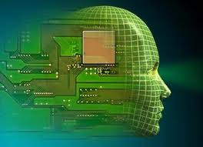
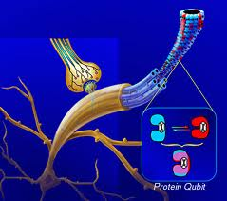
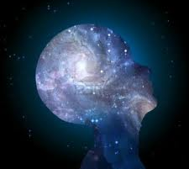
Models of Thoughts
Classical: Thought as brain states/computation
  Thoughts as nerve firing (leading to motion)
  Thoughts as nerve frequency
  Thought as brain connections/resonance
  Combinations of above
Quantum: Thoughts as quantum states
  Thoughts as microtubules coherency/collapse
  Thoughts as quantum tunneling at synapse
  Thoughts as high dimensional vibrations
  Combinations of all above
Spirit: Thoughts separate from body/brain
  Thoughts are pure vibrational energy (quantum things)
  Thoughts as source energy outside spacetime
  No thought and Void
  Combinations of all above

Slide 5
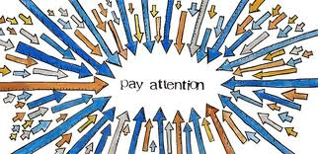
Thought and Attention
Energy flows where attention goes
Attention includes light dimensions of object
Thought in mind is amplified by emotion in body
Law of Attraction works on these principles
Aka chords persist after emotional attention
Emotional events persist in the body till cleared
Energetically sensitive people avoid crowds
Remote staring experiments

Slide 6

Remote Thoughts/Attention
Twins Studies
Lucid and shared Dreams
Remote Staring
Remove Viewing
Orbs as consciousness
Out of Body Experiences (astral travel) & NDE
Remote Healing and Distance Reiki II
Bilocation and teleportation
Telepathy/Attention Experiment

Slide 7
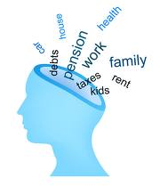

Thought Development
Thought Control
  Observe & remember (stay awake)
  Let thoughts pass by/through
  Rate will slow over time
Thought Discipline
  Maintain one thought for longer periods of time
  Don’t let other thoughts intrude
  Extend time for one thought
Thought Mastery
  No thought – the Void
  Extend time for no thought
From “Initiation into Hermetics” by Franz Bardon

Slide 8

Beliefs are Persistent Thoughts
Beliefs are stable thoughts (think over & over)
Most beliefs are formed before 7 years old
Most beliefs are unconscious
Your language reveals your beliefs
Beliefs have an encoding in your brain/mind
You can change your beliefs and thoughts
Emotional events imprint thoughts/beliefs
  Examples are phobias, multiple personality, combat

Slide 9

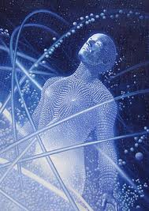
Models of Emotions
Classical: Emotion as body/brain
  Emotions as chemicals, drugs, hormones, glands
  Emotions as nervous system (autonomic , evoked response)
  Emotions as flight or fight response (biofeedback, homeostasis)
  Emotions starting from thoughts (fear, sex, love, dreams)
  Combinations of above
Quantum: Emotion as shared response
  Emotions as crowd response and global consciousness affect
  Emotions as shared emotional bonds (lovers, animals)
  Emotions affected by treatments: anchors, clearing, & grounding
  Emotions as non-local, precognitive, clairvoyance, NDE & 10k pictures
  Combinations of all above
Spirit: Emotion as non-physical energy
  Emotions due to meditation, emotional, astral & mental bodies
  Emotions due to alignment, Reiki, EFT, healing, prayer & chakras
  Combinations of all above

Slide 10
Emotional Memory Loops
Emotions affects Memory
  Biases your neurochemistry affecting memory
  Easy to remember ‘like’ memories since are ‘near’
Memory affects Thoughts/decisions
  Hard to remember other emotional memories
  Make bad decisions due to memory barricades
Thoughts affects Emotions
  Closed loop feeds back into emotional rut
  Break negative emotional loops by choosing ‘relief’

Slide 11
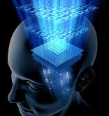
Models of Memory
Memory vs. Communication
Communication moves information thru space
Memory moves of information thru time
People exhibit non-ordinary spacetime
Based on thought representation model
People ‘remember’ things in past/future
People ‘remember’ things from afar
Akashic Records
Representation of all information thru time

Slide 12
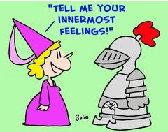


Emotions vs. Feelings
Feelings are internal awareness of emotional state
  More psychological in the mind (mental body)
  Feelings are used for communication (intuition)
  Feeling is the language of the soul
  Most magnificent feeling available is Love
  If you want to know your truth about something,
    quiet your mind and look at how you’re feeling about it
Emotions are created by your thoughts
  More physical in the now body (emotional body)
  Emotion is the power which amplifies/attracts thoughts
  Emotions are used for creation (manifestation)
  The essence/power behind the Law of Attraction
  E-motion is energy in motion.
  You can choose your Emotions
  You’ll then have thoughts based upon feelings
    which produce emotions such as happiness etc

Slide 13


Feeling Good vs. Feeling Bad
“Light” with less mass & time (Light Like or space like & not causal)
Dense vs. light emotions
  Stuck energy is dense & not moving
  Dense emotions pinch off energy
  Light emotions let energy flow
Align emotional body with higher self
  Grounding & clearing emotional body
  Love & joy feels good, fear feels bad
Goal is to ‘enlighten’ yourself
  Relief is choosing ‘lighter’ emotions
“Dense” with more mass & time (time like & causal)

Slide 14
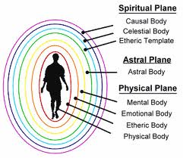
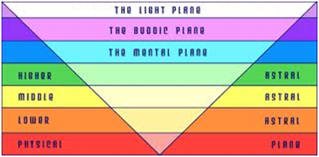
Emotional and Mental Bodies
“Light” with less mass & time
Spiritual/Celestial Body
Astral Body (soul)
Mental Body
Emotional Body
Etheric Body
Physical Body
“Dense” with more mass & time

Slide 15
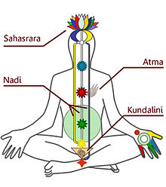
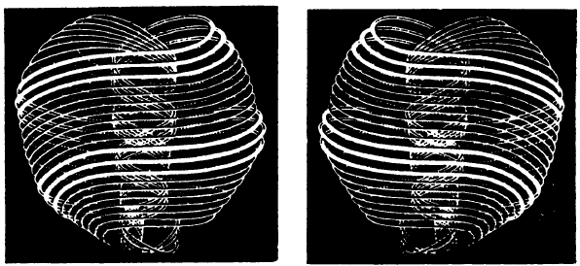
Thoughts and Subtle Energy
Thoughts and Subtle energy are the same
  Both high dimensional source strands
  Inclusion based vibrational clusters
  Intelligent and ubiquitous
  Thought directs subtle energy
  Subtle energies have a feeling
  Thought clusters are called rotes
  Chi, Ki, Prana, Mana, chakras, Anu, Kundalini

Slide 16
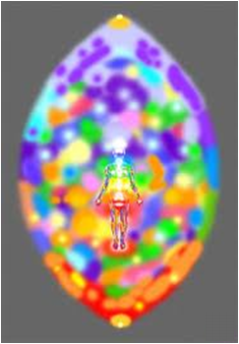
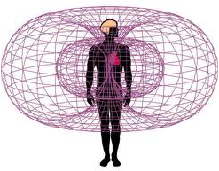
Clearing, Grounding & Alignment
Grounding, clearing & balancing (EFT, QCS)
Meditation and Gridding
Massage, walking and exercise
Breathing and Breathwork
Anchoring and timeline (NLP)
Reframing and energy reframe
Get in the vortex and alignment
Rampage of Appreciation
Energy work & energy combing
Chakras and Heart Intelligence
Acupuncture & Reiki

Slide 17

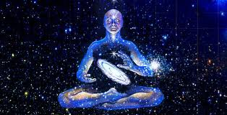
Awakening and Enlightenment
Spiritual Beings of ‘Light’
  No dense/stuck emotional energy
  Observation without judgment
  Deprogram emotional buttons & triggers
Vortex of positive emotional all the time
  Better decisions using positive memories
  More joyful, intuitive and spontaneous
  Become more sensitive as cleared
  Emotion amplifies focused thoughts
Heaven on Earth
  Awakened supermind to include all of higher self
  Spiritual being living joyfully on physical earth

Slide 18
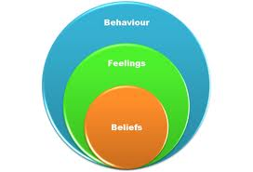

Questions and Discussion
Possible Discussion Topics:
Pinwheel Meditation
Thought forms & rotes
Emotional Ladder
Anchoring
Subtle Energy techniques
Clearing & grounding
Infinite Intelligence

Slide 19
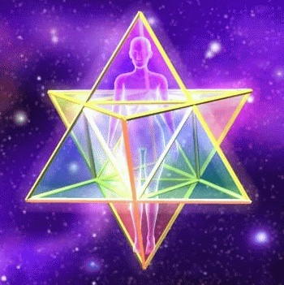
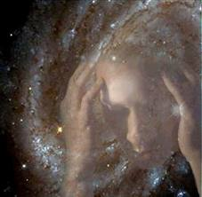
Science of Spiritual Beings Series
Oct 24: Introduction to Science of Spiritual Beings
Oct 31: Science of Law of Attraction
Nov 7: Science of Thoughts, Beliefs, Emotions and Subtle Energy
Nov 14: Science of Daily Living as Spiritual Beings both now and in the future

